Slide 1
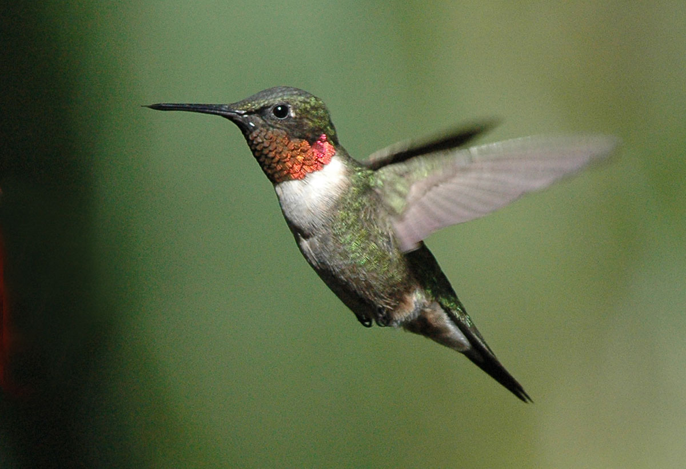
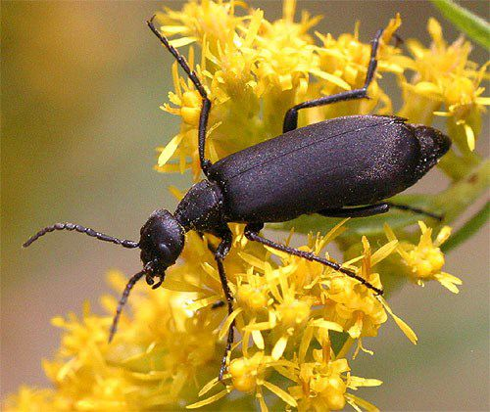
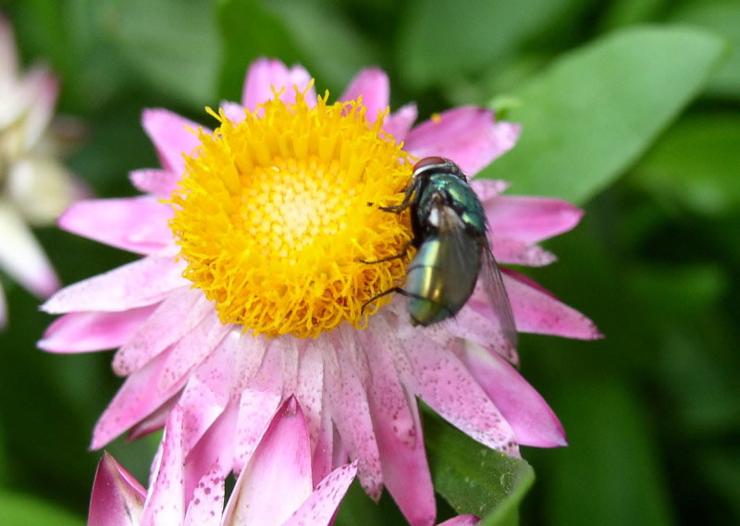
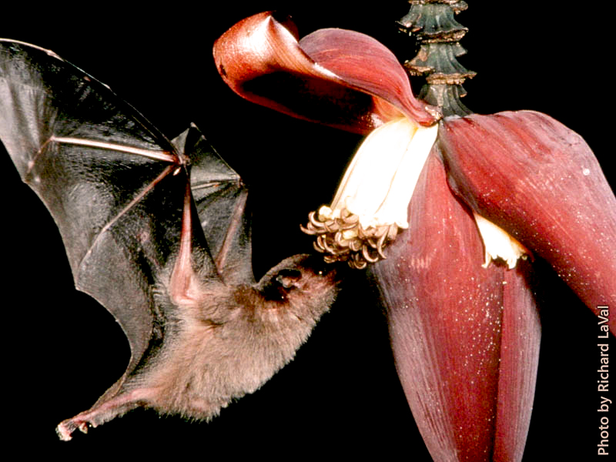
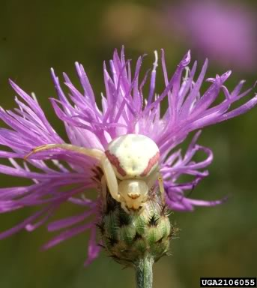
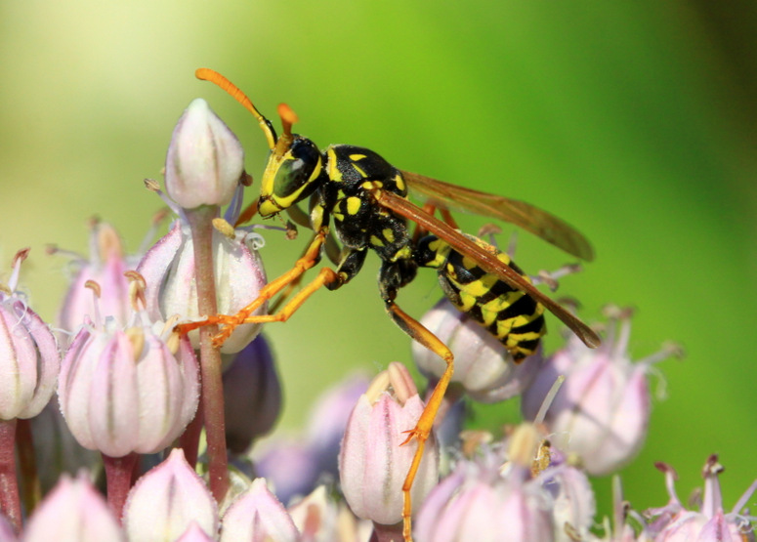
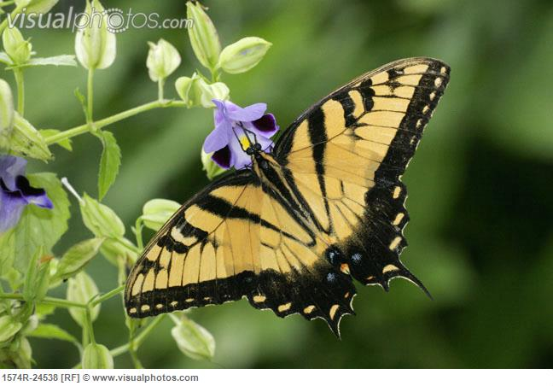
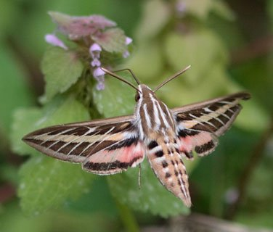
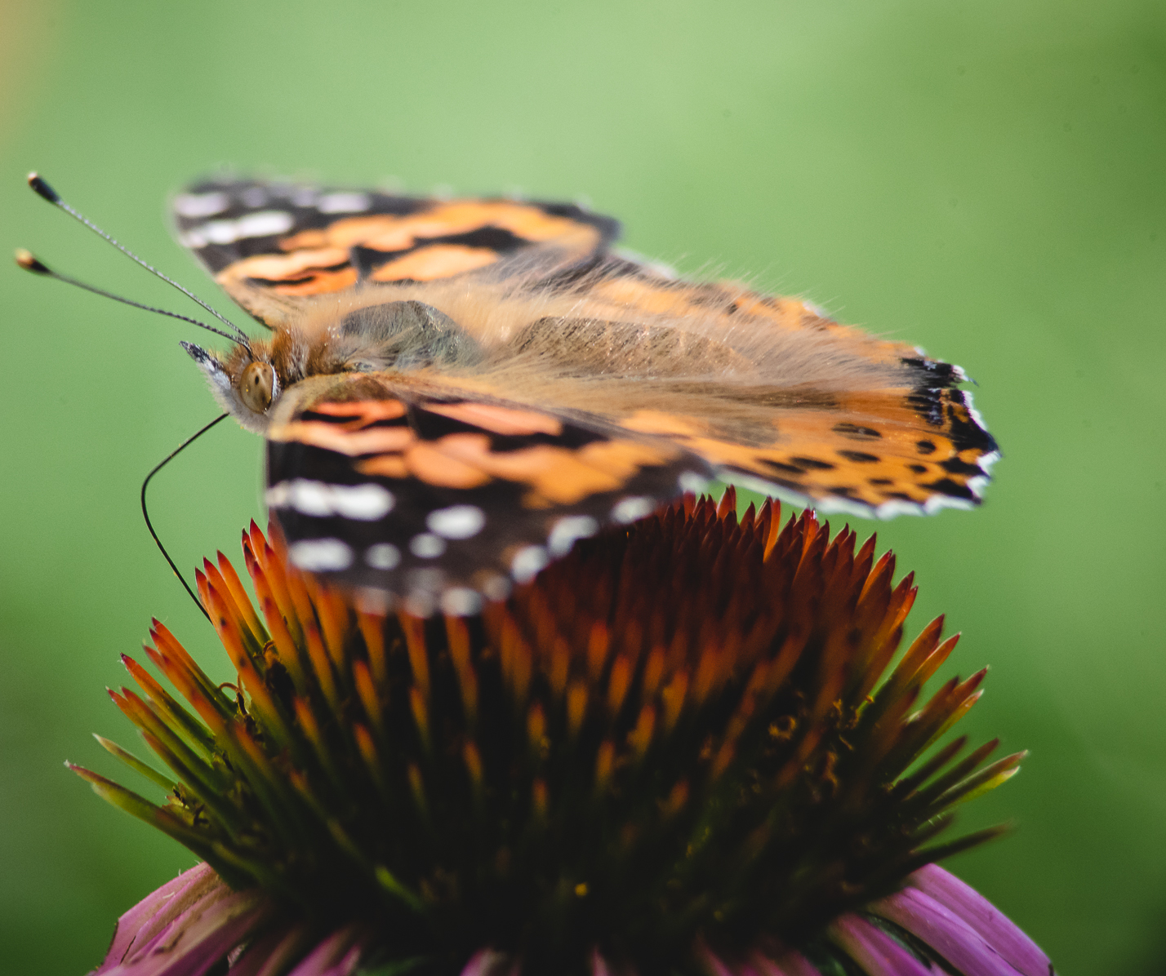
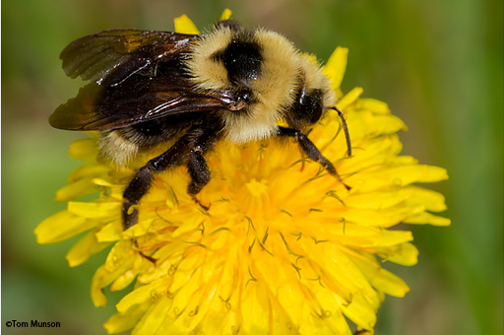
Notes:
· Welcome the participants to your event and introduce yourself and any other important people who helped make this project possible
· Without showing them the first picture, ask the participants to provide some examples of pollinators
· You can then go through the picture and mention the ones they may have missed
Pictures left to right = Hummingbirds, beetles, flys, bats, spiders, wasps, moths, butterflies, bees

Slide 2
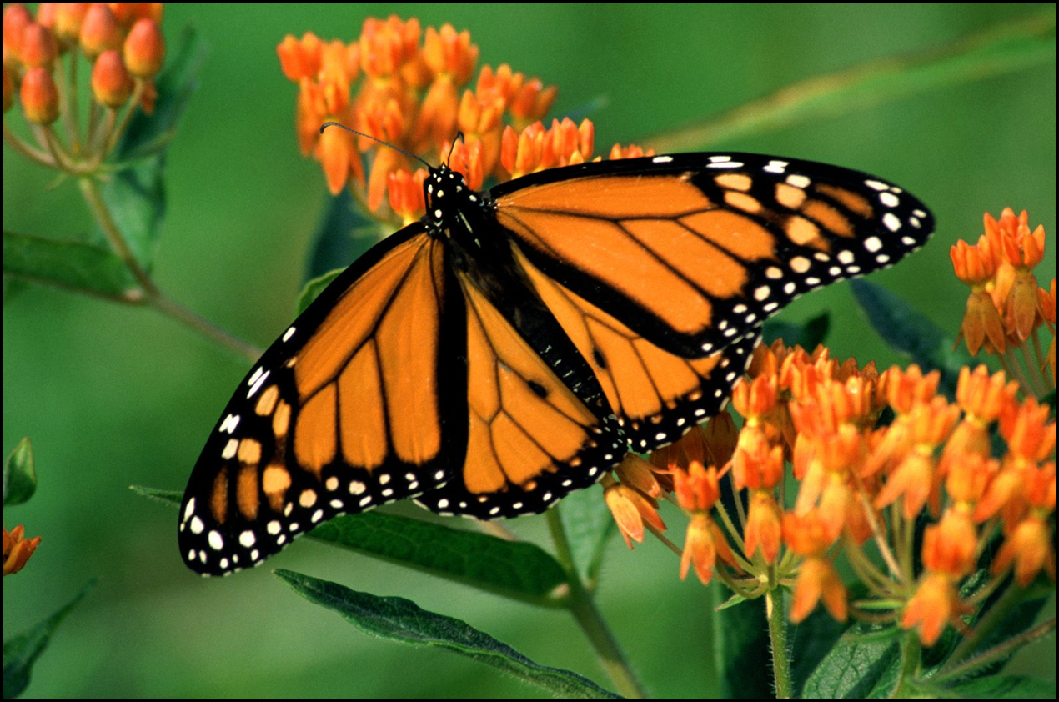
Notes:
· Show the participants the picture #2 and ask them if they can identify the species of butterfly displayed
· After they identify the butterfly as a Monarch, ask the participants what makes this butterfly so popular and well know
· After a number of guesses, explain to them that the one thing that makes this butterfly so unique and popular is its migratory story

Slide 3
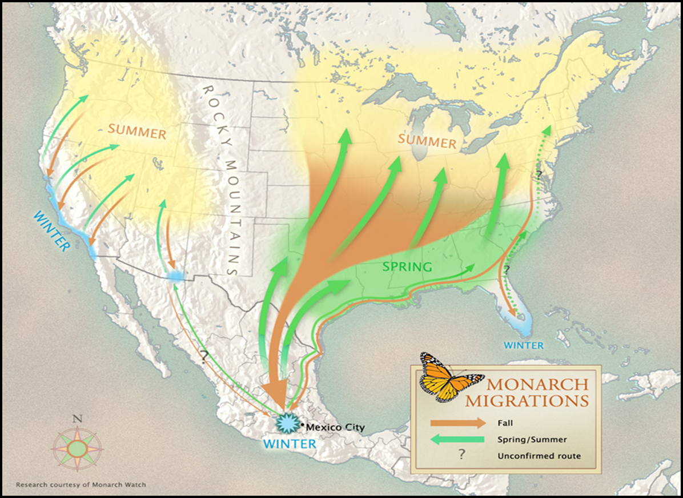
Notes:
· Show the participants the picture #3 and explain the migratory story of the monarch butterfly
· The monarch butterfly migrates from Central Mexico to as far North as Canada in one year
· It takes 4 generations for the butterfly to make its annual migration
· The 1st-3rd generation butterflies live about 1 month
· The 4th generation butterfly lives 6-8 months and overwinters in Central Mexico

Slide 4
Notes:
· The monarch butterfly population has been on a steady decrease for the late two decades
· The monarch butterfly population has decreased 90% over the last two decades
· Before showing the next photo, ask the participants if they know why the monarch butterfly population has been decreasing

Slide 5
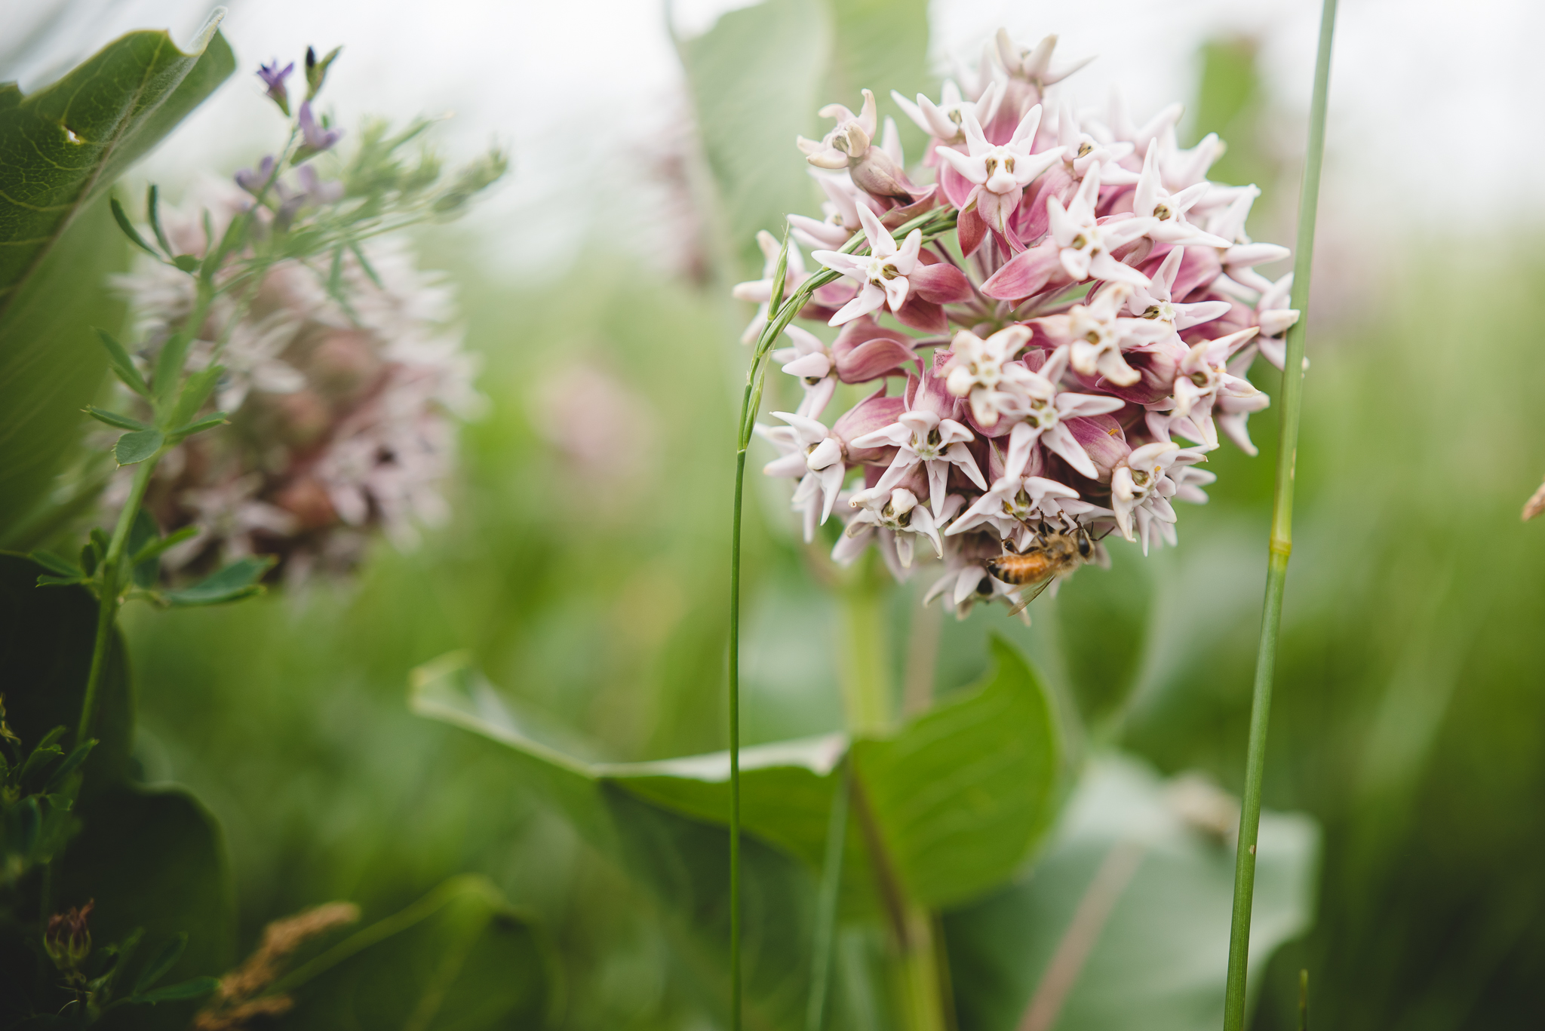
Notes:
· The main cause of monarch decline can be tied to the lack of milkweed throughout the Midwest
· Monarch butterflies only lay their eggs on milkweed plants
· There are over 120 species of milkweed in the U.S.
· The most important milkweed species to monarchs is common milkweed (pictured)

Slide 6
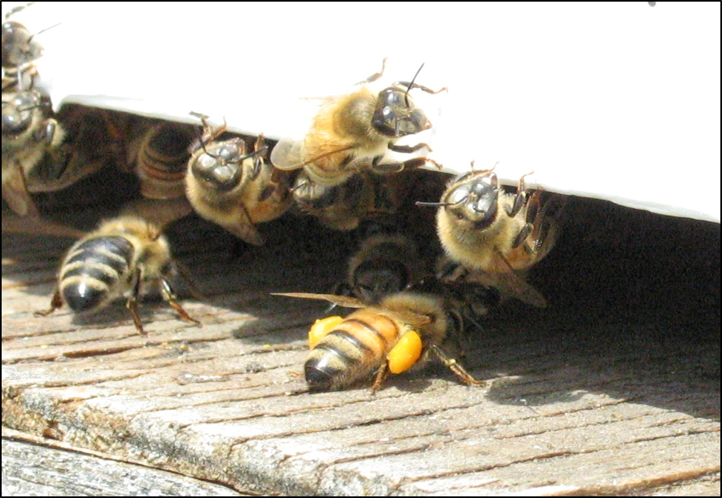
Notes:
· Show the participants the picture of the bee and ask them if they can name the species (honey bee)
· After they name the species, explain to them that the honey bee is also experiencing a decline in its population and show them the next slide (graph)

Slide 7
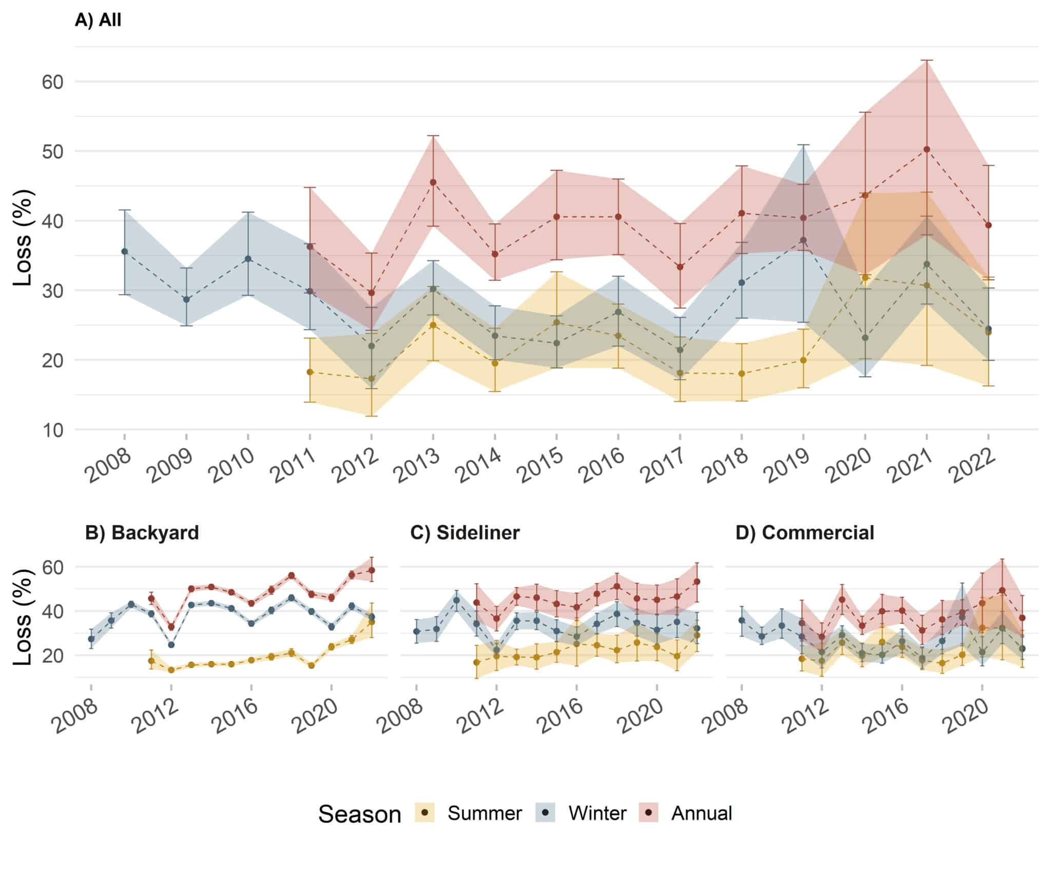
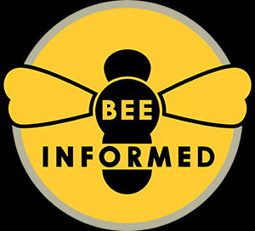
Honey Bee Loss
Notes:
· Honey bee keepers are reporting annual losses over 40% which is not sustainable over a long period of time
· This is extremely alarming as the honey bee is responsible for creating 1 out of every 3 bites of food we eat each day
· Before showing them the next graph, ask the participants if they know why the honey bee is declining in population

Slide 8
Notes:
· Like monarch butterflies, honey bees visit wildflowers to feed on pollen and nectar.
· Like humans, honey bees need a diverse diet to keep their immune systems healthy. Unhealthy diets make them susceptible to disease.
· Since there is a lack of diversity of flowering plants on the landscape, scientist believe that poor nutrition is to blame for honey bee population decreases.
· Areas that provide a diversity of blooming plants, like the photo. provide pollinators a variety of nutrients to keep them healthy.

Slide 9
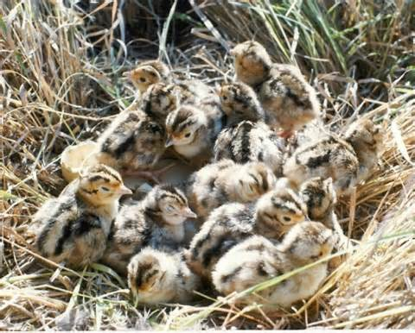
Notes:
· Pheasants Forever and Quail Forever are very interested in establishing quality pollinator habitat across the country.
· Pollinator habitat is very important to pheasant and quail chicks.
· Would anyone like to guess what pheasant (pictured) and quail chicks feed on for the first six to eight weeks of life?

Slide 10
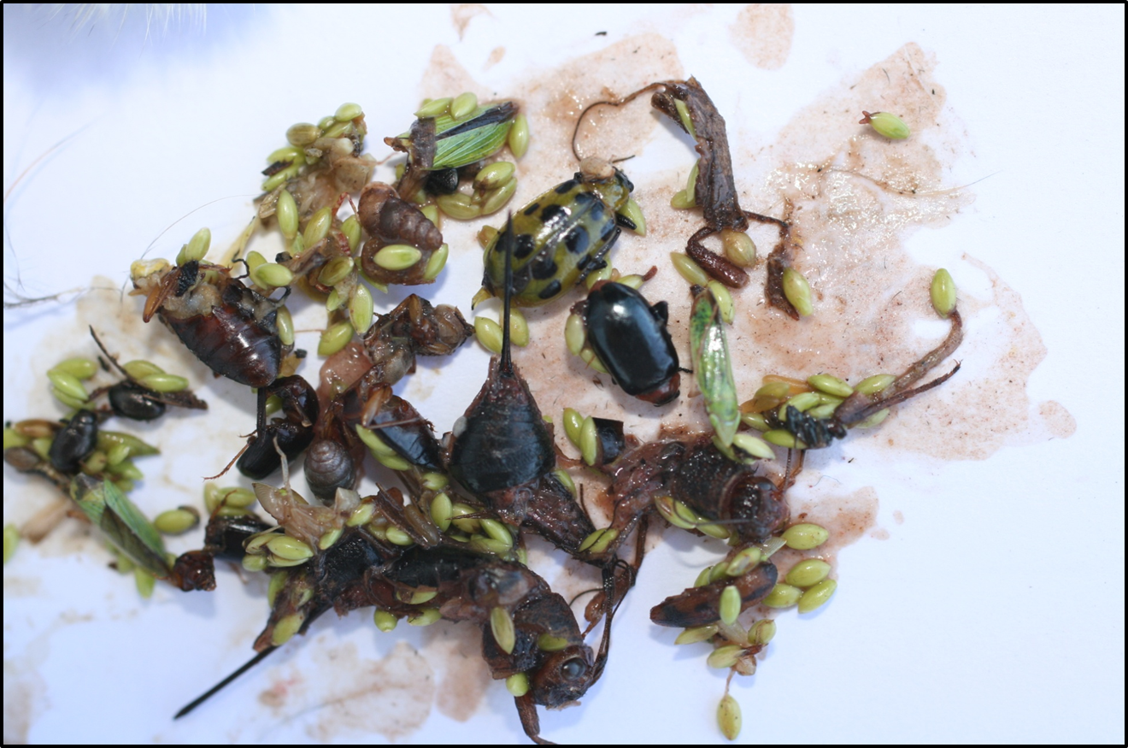
Notes:
· Pheasant and quail chicks feed exclusively on soft-bodied insects (pollinators) for the first six to eight weeks of life.
· Pictured here is the crop (stomach) contents of a young quail check. As you can see, the majority of what they eat are soft bodied insects.
· Insects provide a very good source of protein for chicks and help them grow quickly to avoid predators.

Slide 11
Notes:
· What you are doing here today is helping provide valuable habitat for birds, bees and butterflies.
· Our goal is to establish a pollinator plot that looks similar to the photo in a few years.

